Slide 1
Examining the Impact of Microphysics Parameters in WRF Simulations of a January 2019 Vermont Winter Storm
Michael Wasserstein

Slide 2
Objectives
Examine the physics of the clouds in a Jan 2019 winter storm in VT
Track precipitation data at various sites for computer simulations of the storm
Compare results to real observations at sea level site (Middlebury) and mountain site (Rochester)
Notes:
Define jargon - mp

Slide 3
The January 20-21, 2019 Winter Storm
Timing
Temperatures < 0 °F
10:1 Snow : liquid ratio
NWS Burlington
Notes:
Explain snow totals in VT and northern NY from the storm
Explain the storm’s cold nature / what does that mean for snowfall totals? (10:1 snowfall ratio)
Discuss the brutal winds
My personal memory - going to snow bowl to ski – only lasting 30 minutes due to cold and wind

Slide 4
Methods
Thompson
WDM6
ETA (Ferrier)
Morrison 2 moment
NCAR
NCAR
NCAR Command Language
Wolfram
Notes:
Photos with code can be good
WRF – the key method to simulate 48 hours of weather (explain what the model is)
Used 4 different microphysics parameterizations with different physics controls
5 km grid spacing, hourly data output, Latitude: 44.0 °, Longitude: -73.03 °
Data were taken from GFS reanalysis
Data analysis through NCL and mathematica

Slide 5
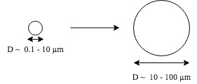
Cloud Microphysics
Study of tiny particles in clouds
Collision rate of cloud particles:
τ⁻¹_{coal} ≈ ( π ρ_{p} g / 9η) N r_{M}⁴
Particles grow, atmosphere becomes saturated, fall as precipitation
Such a complex process, how can we model it …?
Notes:
Condensation nuclei causes particles to stick, eventually growing to cloud particle, growing to rain drop (1 mm)
Qp is particle mass debsity
G is acceleration due to gravity
Weird n is atmospheric viscosity
N is number density of cloud particles
rM is size of particle
From equation, we can see that for particles to grow, they must stick together – larger particles are better at sticking. Air in between small particles can sometimes prevent sticking. At very cold temperatutre – ice particles dont stick well.

Slide 6
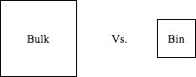
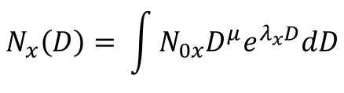
Cloud microphysics modeling
 | Thompson | WDM6 | Eta (Ferrier) | Morrison 2 Moment
Moment | 1 | 2 | 1 | 2
Mass Variables | Qc, Qr, Qi, Qs, Qg | Qc, Qr, Qi, Qs, Qg | Qc, Qr, Qs, Qt | Qc, Qr, Qi, Qs, Qg
Number Variables | Ni, Nr | Nn, Nc, Nr |  | Nr, Ni, Ns, Ng
Snow Density | Varies with size | Fixed | Fixed | Fixed
Bulk scheme uses Gamma distribution as particle size distribution (many assumptions at play)
$$N_{x}\left(D\right)= \int{N_{0x}D^{μ}e^{λ_{x}D}dD}$$
(Galligani et al. 2017)
Notes:
Bin microphyisics scheme – calculate microphysics as accurately as possible – particles in different bins for different sizes, compute evolution of each bin separately
Bulk microphyscs schem calculates with semi-empirical particle size distribution (bulk is more practicle – used here)
Qt* - Total condensates
Nn – CCN number (cloud condensation nuclei)
Eqn – based on diameter, how frequently are particles present?
NxD = number concentration
X – hydrometeor class (rain/ snow, etc.)
D is diameter
Nox = y intercept parameter
Lambdax = slope parameter
Mu x = shape paramater

Slide 7
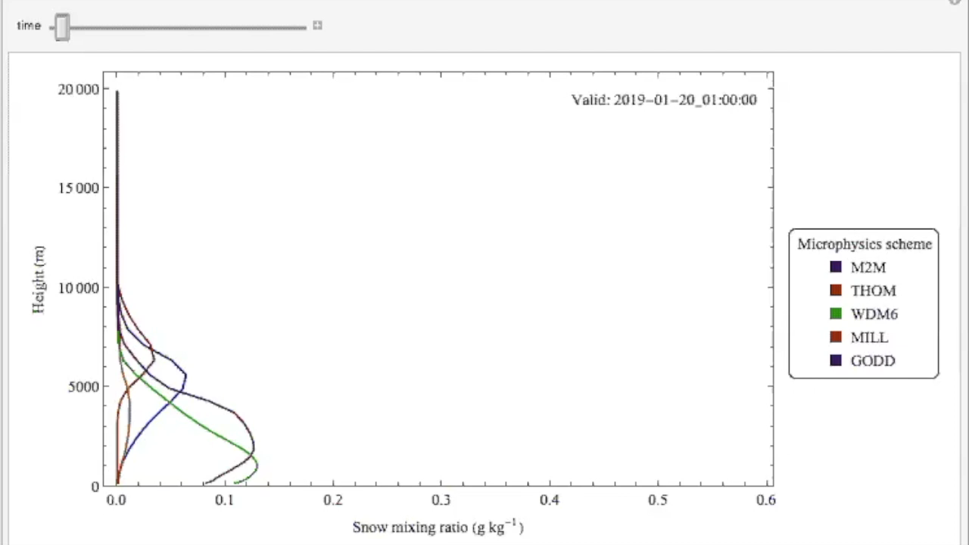
Results

Slide 8
Analysis
Here I will give a brief discussion of which microphysics scheme best predicts snowfall for the storm, and what that means for selecting MP parameterizations when weather modeling and how this can inform operational forecasting.
I will also compare my results to similar studies of MP (McMillen and Steenburgh, 2015; Jankov, et al. 2011)

Slide 9
Future directions
Analyze other microphysics parameterizations not chosen in this project
Modify other aspects of the WRF physics (Cumulus physics, radiation, land surface physics, etc.)

